Slide 1



GROUP PROJECT ONE
An analysis of Australian dining habits using data from Zomato, Gourmet Traveller and the Good Food Guide.

Slide 2
Mickey Sandhu
Brad Smith
&
Nelson Paulo Balino
OUR
TEAM

Slide 3
PROPOSAL
This project analyses dining habits in three Australian cities (Melbourne, Sydney, and Perth). In particular the following questions will be posited;
Most popular restaurants in each city according to Zomato
Most popular cuisines in each city according to Zomato
Top cuisines and restaurants in Australia according to Zomato
Top restaurants in Australia according to Gourmet Traveller (2019)
Top restaurants in Australia according to Good Food Guide (2020)
Whether there is any similarities between popular restaurants according to Zomato reviewers and those judged Australia's finest by Gourmet Traveller (2019) and Good Food Guide Awards (2020)

Slide 4


DATA SOURCES

Slide 5
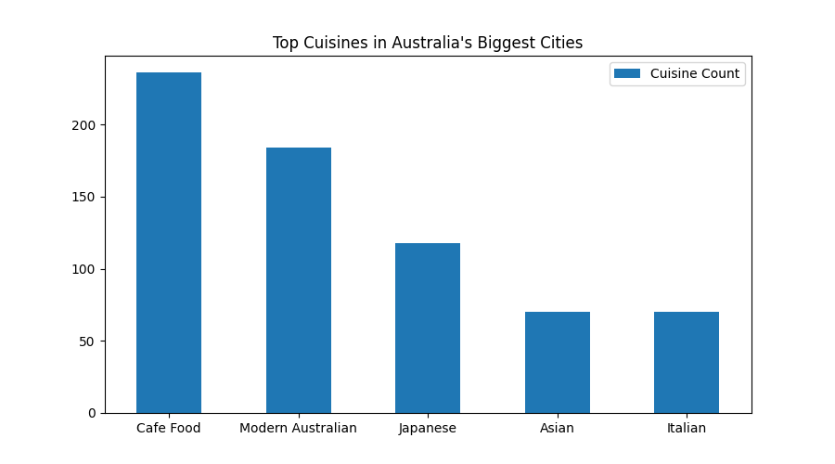
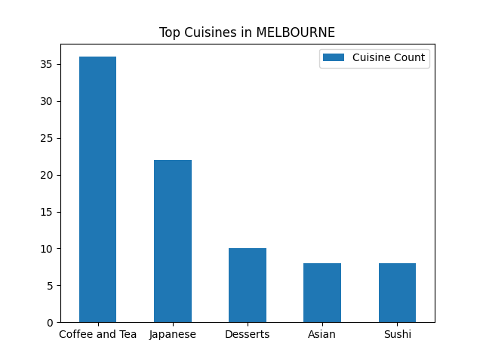
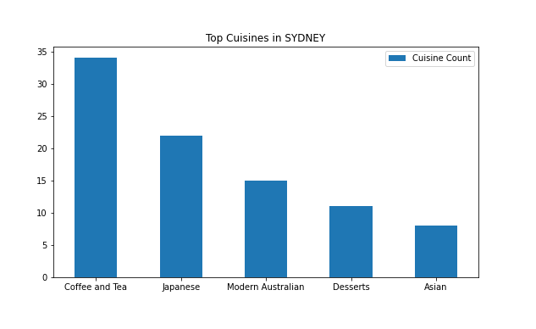
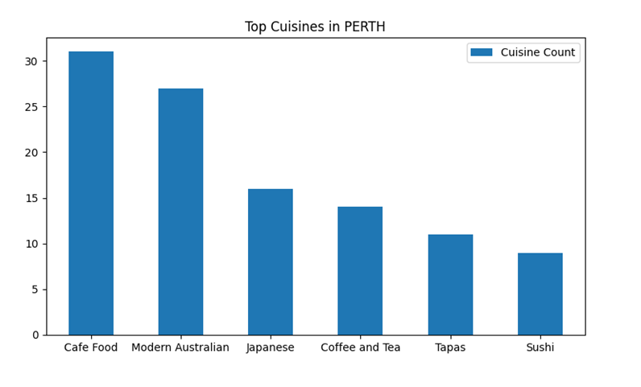

Slide 10
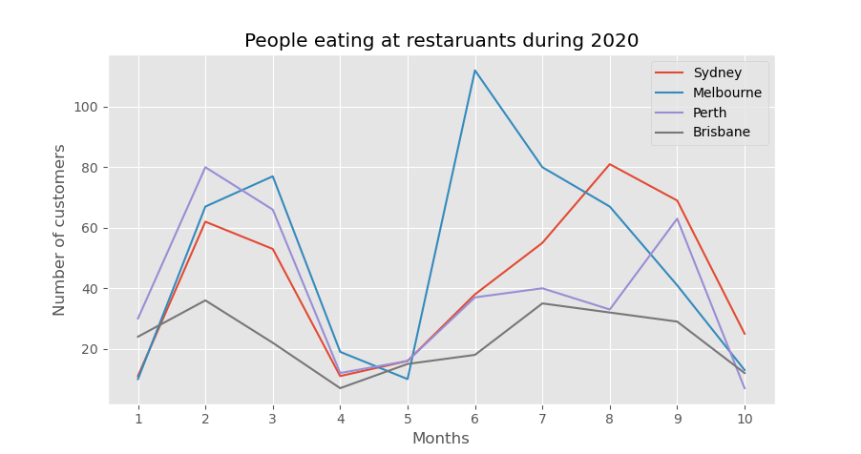

Slide 11
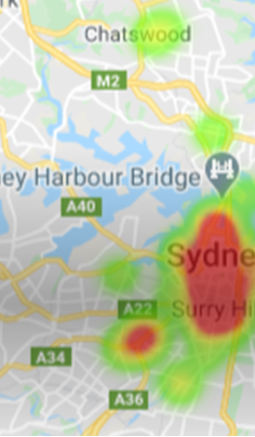
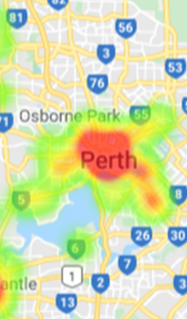
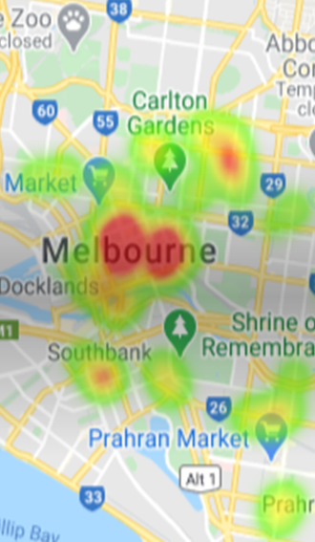

Slide 12
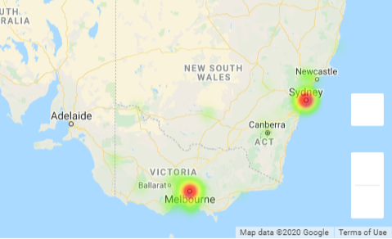
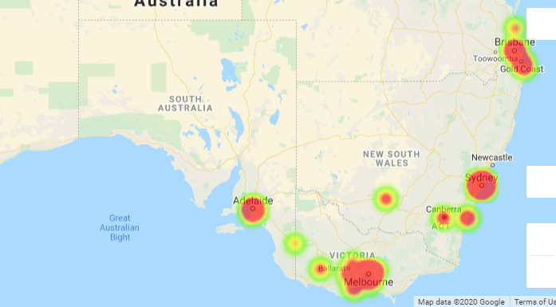

Slide 13
